Slide 1


A Real-Time Research Project Presentation on
IoT Based Home Automation System-ESP8266
Presented by
Name Roll No.
Ms. Sripriya Rathod 22wh1a0205
Ms. Janani Nagarajan 22wh1a0218
Ms. Jessi Elina 22wh1a0215
Ms. Srigiri Advaitha 22wh1a0209
Supervised by
Mrs. B Sujatha
Associate Professor, EEE
Department of Electrical & Electronics Engineering
BVRIT HYDERABAD College of Engineering for Women

Slide 2
Abstract
The aim of the project is to build a home automation system with the ESP8266 Wi-Fi module.
The ESP8266 microcontroller and two-channel relays are the essential components of the system that allow for the real-time monitoring and control of appliances, as well as security systems.
The system will give users an accessible, flexible, and scalable way for controlling appliances in the home.
Users can efficiently handle their home environment via a web interface or smartphone application to control the system remotely.
1

Slide 3
Introduction
Home automation enhances convenience, comfort, and energy efficiency by using smart technology to control household appliances.
The Internet of Things (IoT) allows remote control and monitoring of devices, improving convenience, security, and energy optimization. IoT technology improves convenience by allowing users to control devices from anywhere.
Affordable solutions like the ESP8266, a low-cost Wi-Fi microchip with microcontroller capabilities, make home automation accessible.
The ESP8266 connects to home Wi-Fi, interacts with actuators, and can be programmed and controlled remotely, creating a smart, efficient, and secure home environment.
2

Slide 4
Literature Survey
References | Summary of the work
[1] | Using ESP8266 for remote home appliance control via web or mobile, emphasizing ease, cost-effectiveness, and energy efficiency.
[2] | IoT smart home system uses ESP8266 for device integration, emphasizing user-friendly interfaces and scalability for expansion.
[3] | Review praises ESP8266 in IoT home automation for cost and reliability.
[4] | ESP8266-based IoT home system uses Android app for easy appliance control, catering to non-technical users.
[5] | IoT home automation integrates actuators using ESP8266 for real-time control.
3

Slide 5
Objective
Develop an IoT based home automation which helps in controlling the household appliances efficiently.
It enhances user interaction through user friendly interfaces such as switching controls in mobile app.
Implementing affordable home automation.
4

Slide 6
Methodology
Implementing an IoT-based home automation system using the ESP8266 involves several steps, including setting up the hardware, programming the microcontroller, and integrating it with a cloud service like Blynk.
Step 1: Define the Project Scope
Determine the devices and appliances required to be automated (e.g., lights, fans, temperature sensors) and the functionalities required (e.g., monitoring).
Step 2: Gather Components
ESP8266: A popular Wi-Fi module used for IoT projects.
Two channel relay: To control high-voltage appliances.
Power Supply: Appropriate power source for the ESP8266 and connected components.
Breadboard and Jumper Wires: For prototyping the circuit.
5

Slide 7
Step 3: Set Up the Hardware
Connect the ESP8266:
Power the ESP8266 using a suitable power source (typically 3.3V).
Connect the GPIO pins of the ESP8266 to the relay modules and sensors.
Ensure proper grounding and connections to avoid hardware damage.
Relay Module Connection:
Connect the input pins of the relay module to the GPIO pins of the ESP8266.
Connect ground and power supply pins
Step 4: Program the ESP8266
Install Arduino IDE:
Download and install the Arduino IDE from the official website.
Install the ESP8266 board package via the Boards Manager.
6

Slide 8
Install Libraries:
Install necessary libraries, such as the Blynk library and any sensor-specific libraries.
Write the Code:
Initialize the Blynk library with your authentication token.
Define the pin configurations and sensor read/write logic.
Implement the logic to read sensor data and control appliances based on received commands.
Upload the Code:
Connect the ESP8266 to your computer via a USB-to-Serial adapter.
Upload the code to the ESP8266 using the Arduino IDE.
Step 5: Configure Blynk
Set Up the Mobile App: Add widgets to your project to control and monitor your devices (e.g., buttons, sliders, graphs).
Get Auth Token: Obtain the authentication token from the Blynk app and include it in your ESP8266 code.
7

Slide 9
Step 6: Test and Debug
Test Connectivity: Ensure the ESP8266 connects to your Wi-Fi network and communicates with the Blynk server.
Test Functionality: Verify that you can control appliances and read sensor data through the Blynk app.
Debug: Troubleshoot any issues with hardware connections, code, or network connectivity.
Step 7: Deployment
Install at Home: Install the system in your home, ensuring it is safely integrated with your home’s electrical system.

Slide 10
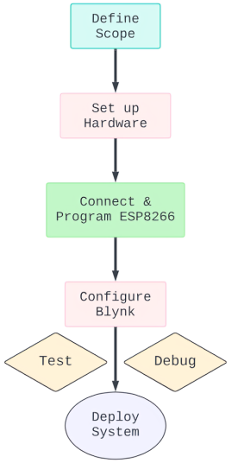
This methodology provides a structured approach to creating an IoT-based home automation system using the ESP8266, ensuring a comprehensive and secure setup.

Slide 11
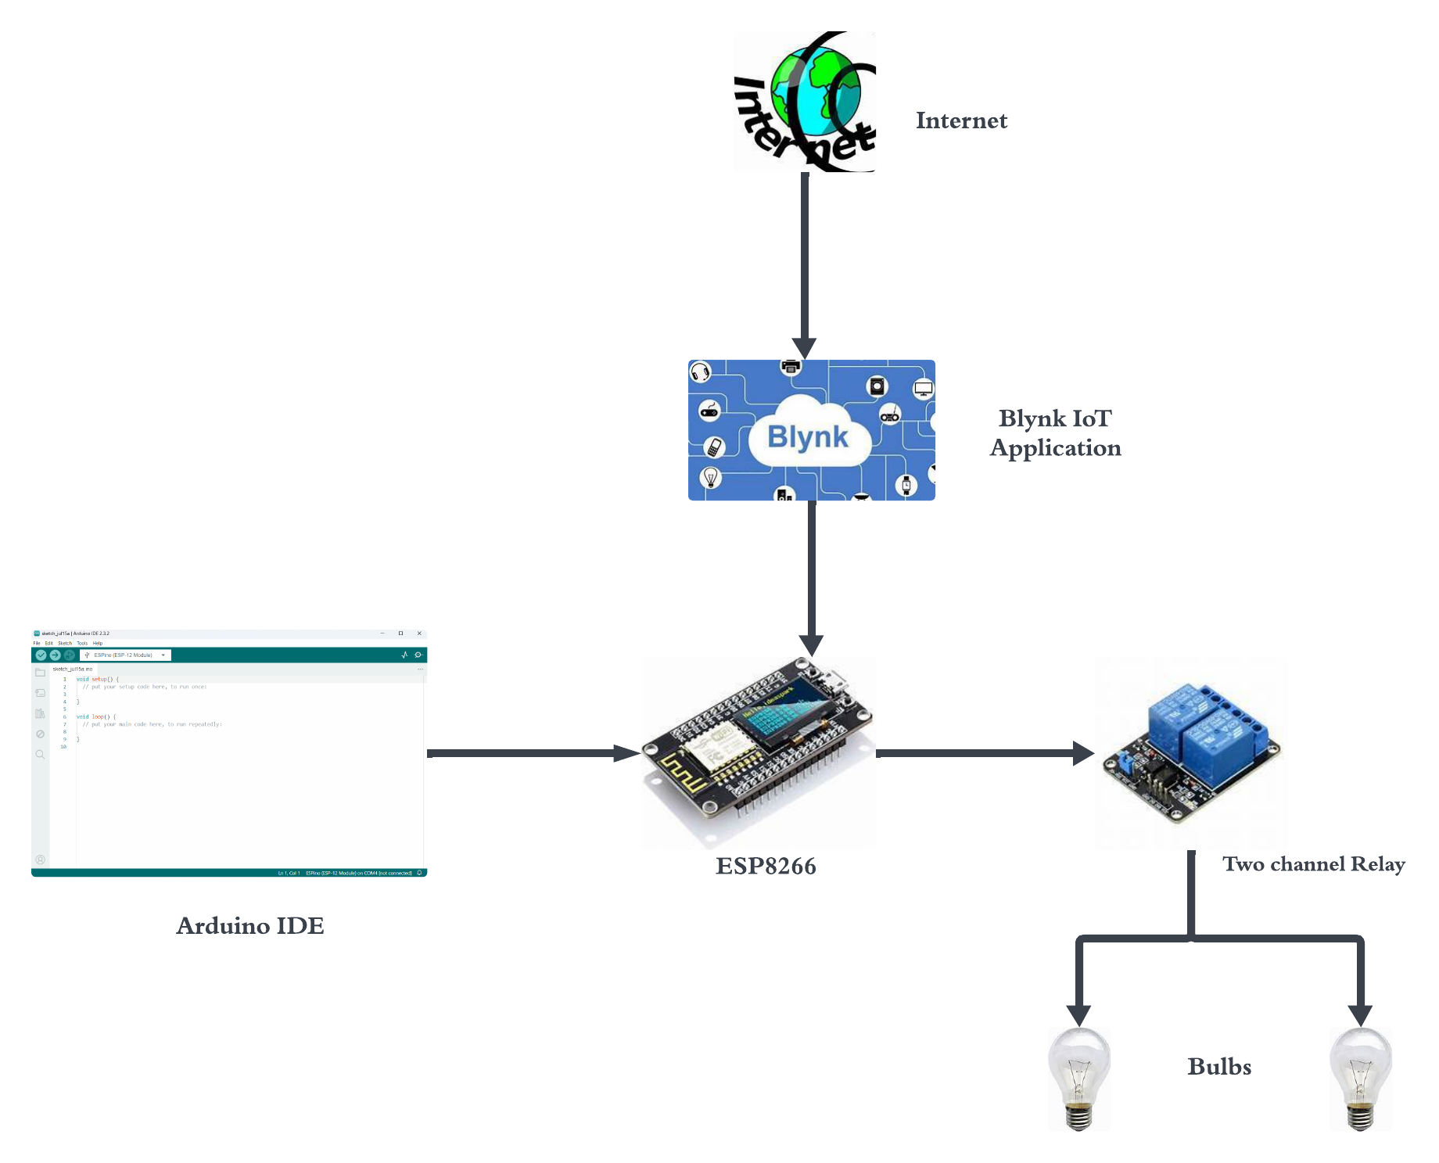
Overview

Slide 12
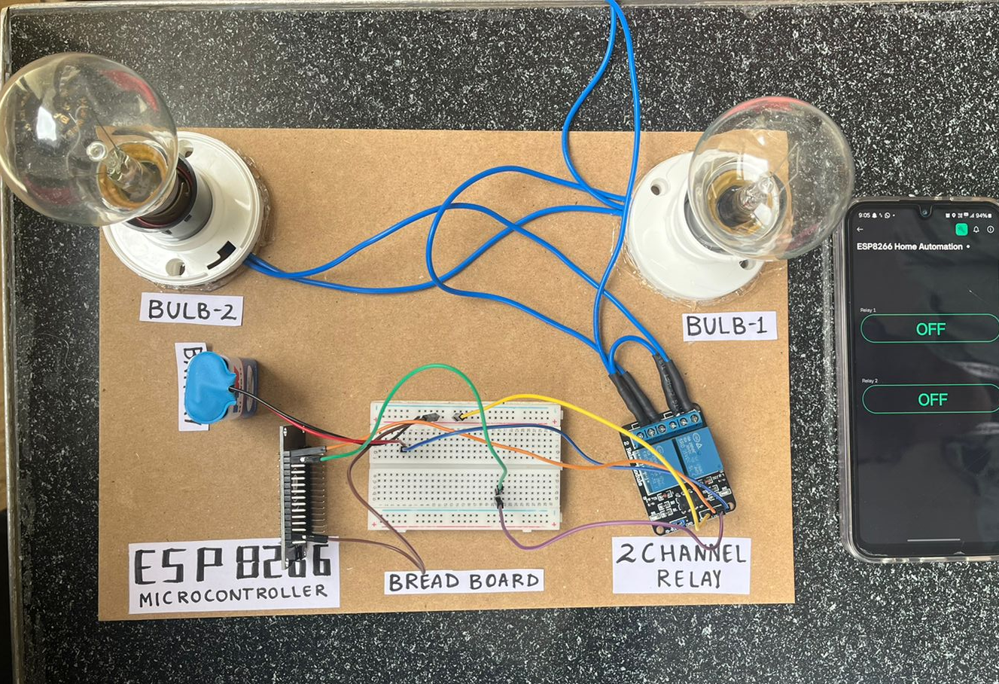
Result

Slide 13
Conclusion
IoT based Home automation using ESP8266 utilizes smart technology and IoT to significantly enhance household convenience, comfort, and energy efficiency.
By connecting to Wi-Fi and interacting with various sensors and actuators, the ESP8266 enables users to control and monitor their home environment from anywhere in the world.
This project demonstrates the potential of affordable home automation solutions to create smart, secure, and efficient living spaces.
Future development can include integrating the home automation system with popular voice assistants like Amazon Alexa, Google Assistant, and Apple Siri for hands-free control.
Adding advanced security features such as facial recognition, biometric access, and enhanced encryption protocols to improve the security of the home automation system by creating our own application like Blynk.
12

Slide 14
Reference
Pavithra, D., & Balakrishnan, R. (2015, April). IoT based monitoring and control system for home automation. In 2015 global conference on communication technologies (GCCT) (pp. 169-173). IEEE.
Stolojescu-Crisan, C., Crisan, C., & Butunoi, B. P. (2021). An IoT-based smart home automation system. Sensors, 21(11), 3784.
Sivapriyan, R., Rao, K. M., & Harijyothi, M. (2020, January). Literature review of iot based home automation system. In 2020 Fourth International Conference on Inventive Systems and Control (ICISC) (pp. 101-105). IEEE.
Reddy, P. S. N., Reddy, K. T. K., Reddy, P. A. K., Ramaiah, G. K., & Kishor, S. N. (2016, October). An IoT based home automation using android application. In 2016 International conference on signal processing, communication, power and embedded system (SCOPES) (pp. 285-290). IEEE
.
Garg, S., Yadav, A., Jamloki, S., Sadana, A., & Tharani, K. (2020). IoT based home automation. Journal of Information and Optimization Sciences, 41(1), 261-271.
13

Slide 15
Thank You

